Slide 1



Build Powerful Layouts
to Have a Better Clean Code
Shlomi Levi
@wizardnet972

Slide 2
Layout?
@wizardnet972

Slide 3

Layout - CSS?
@wizardnet972
<div class="container">
<div class="row">
<div class="col-sm">
One of three columns
</div>
<div class="col-sm">
One of three columns
</div>
<div class="col-sm">
One of three columns
</div>
</div>
</div>

Slide 4
Layout – some flex lib-*?
@wizardnet972
<div fxLayout="column" class="bigger">
<div fxLayout="row"
fxLayoutAlign="start center"
fxLayoutGap="20px"
style="height:30px; min-height:30px;">
<h2>Layout Demos: </h2>
<span>Version: {{version}}</span>
</div>
<div fxLayout="column" fxLayoutAlign="left top" style="font-size: 0.85em;">
These Layout demos are curated from the Angular Material...
…

Slide 5
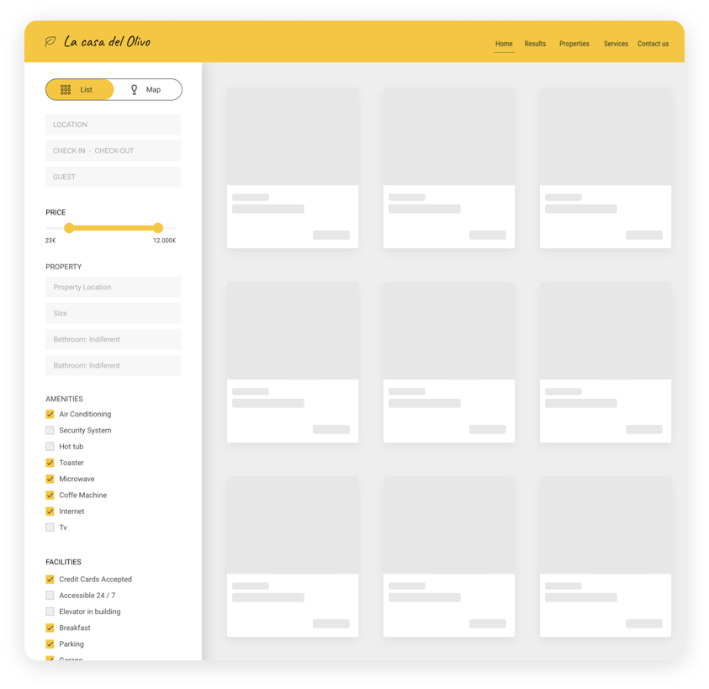

Layout: the structure of our application
@wizardnet972

Slide 6
Layout: the structure of our application
@wizardnet972

Slide 7
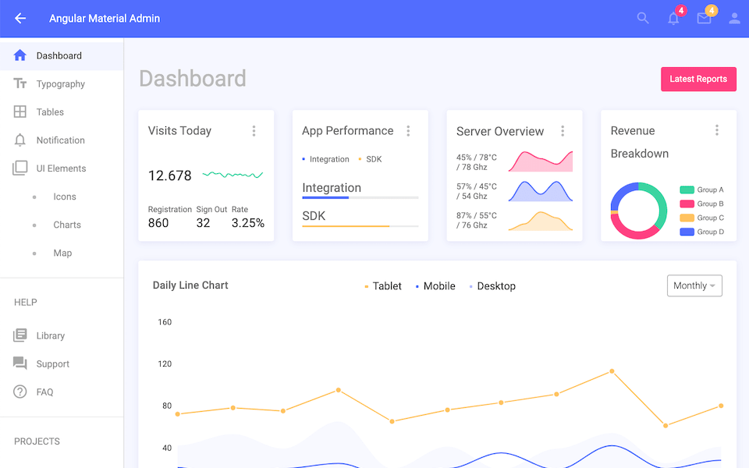
Layout
@wizardnet972
Content
(usually replaced
by the router)
👈
👉
Application Shell

Slide 8
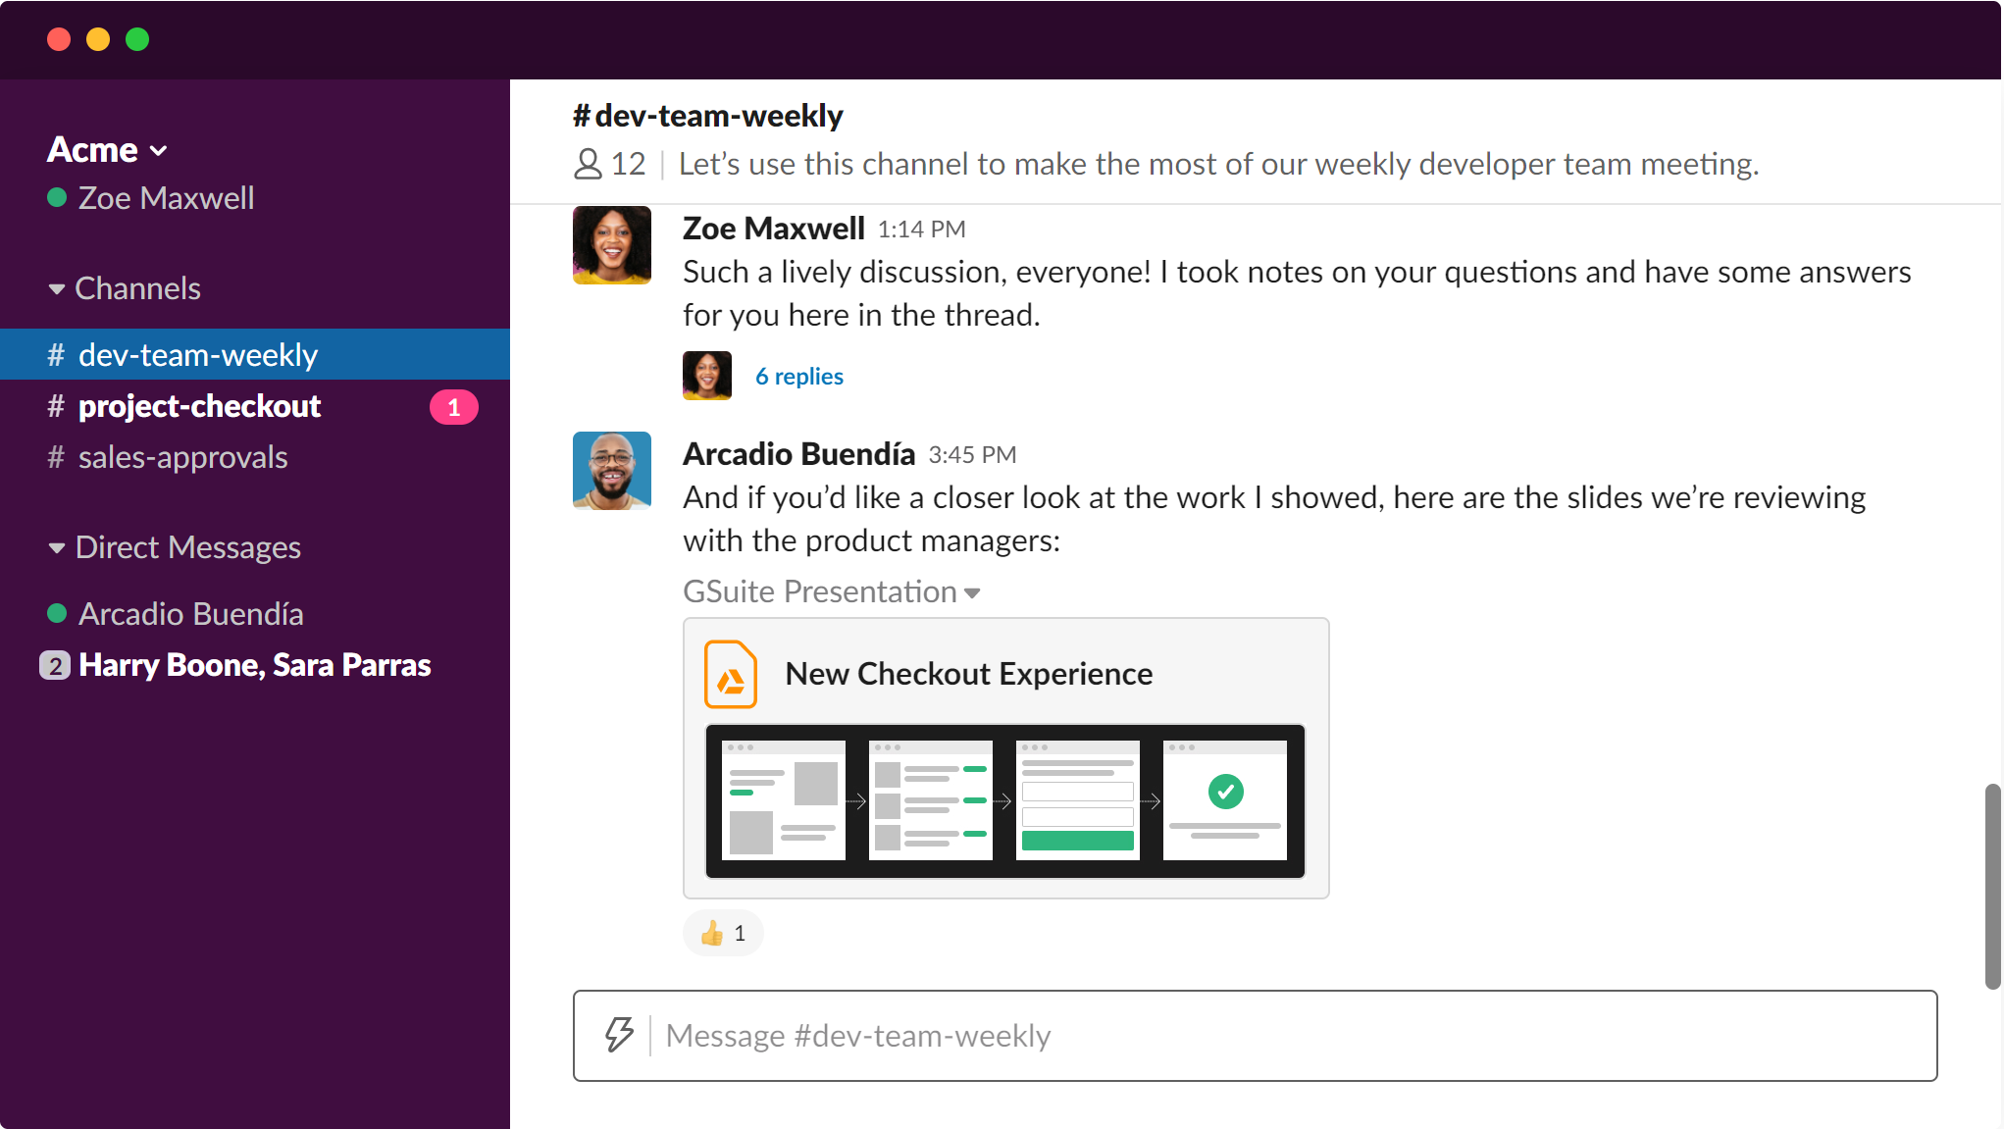
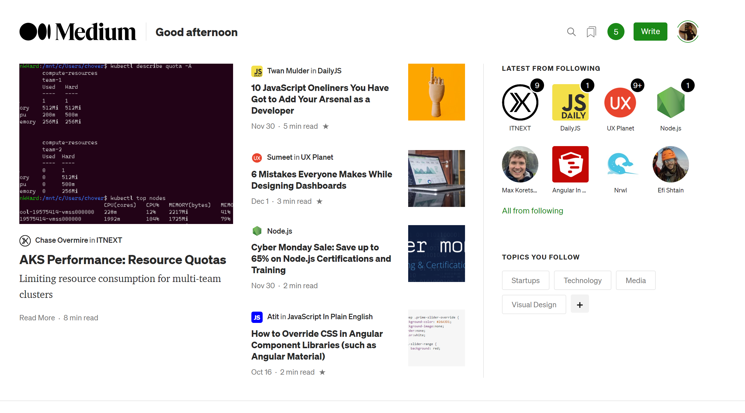
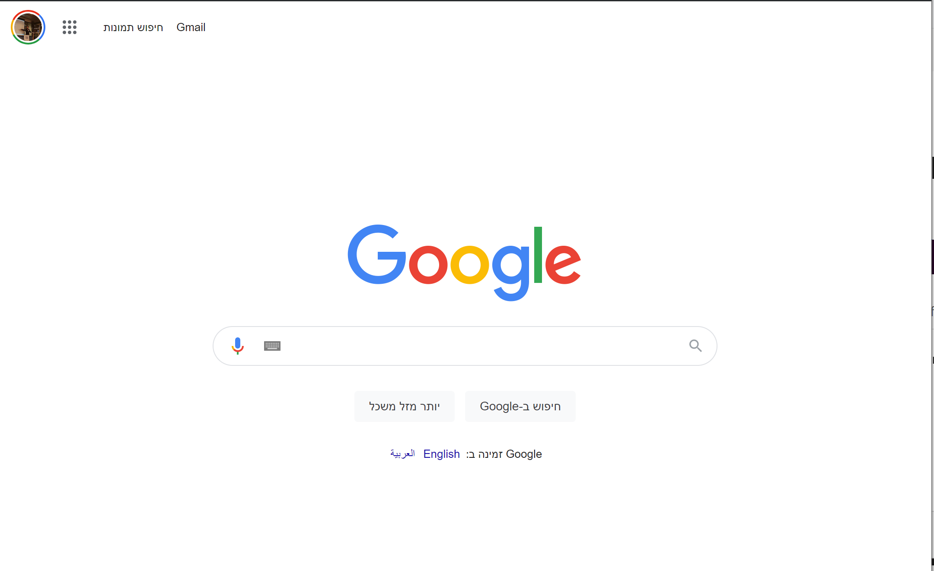
Layouts
@wizardnet972

Slide 9
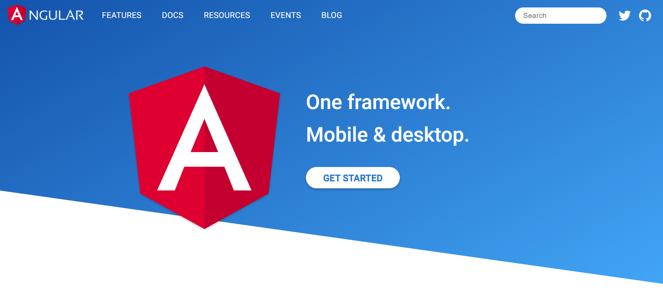
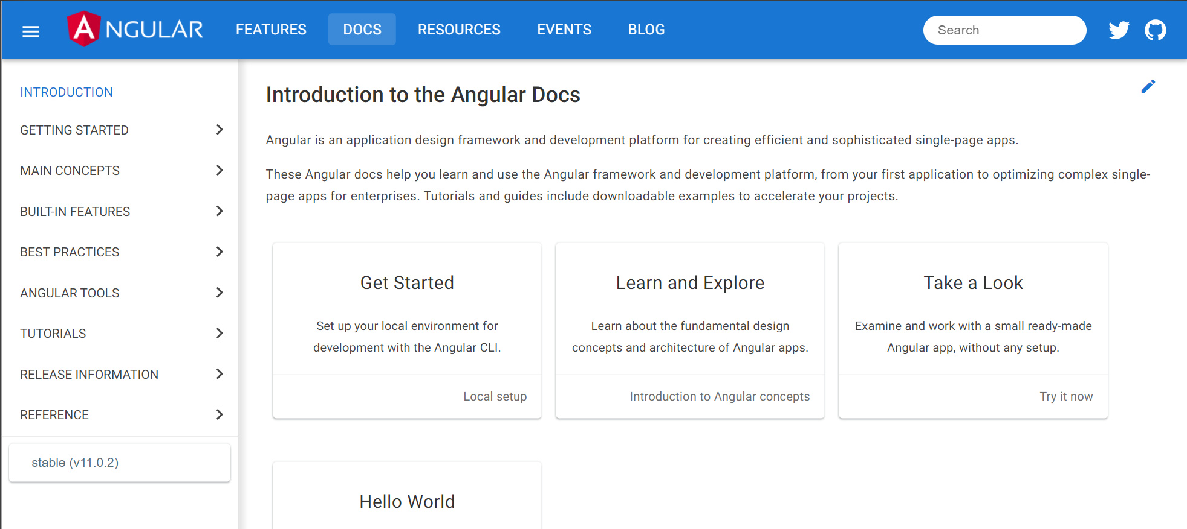
Example: angular.io
@wizardnet972
Homepage
Inner page
👇
👇
👈
👈
👈

Slide 10
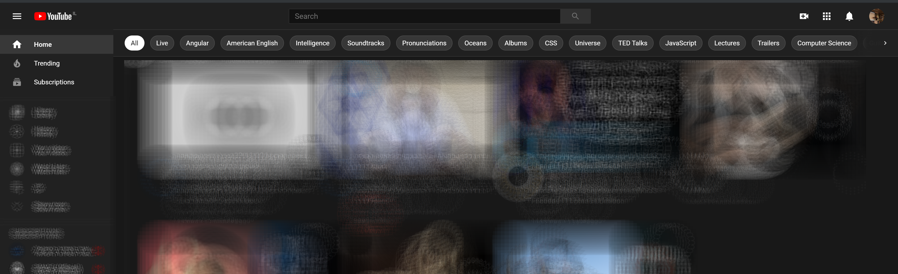

Example: youtube.com
@wizardnet972
Homepage
Video page
👇
👇
👈
👈
👈

Slide 11
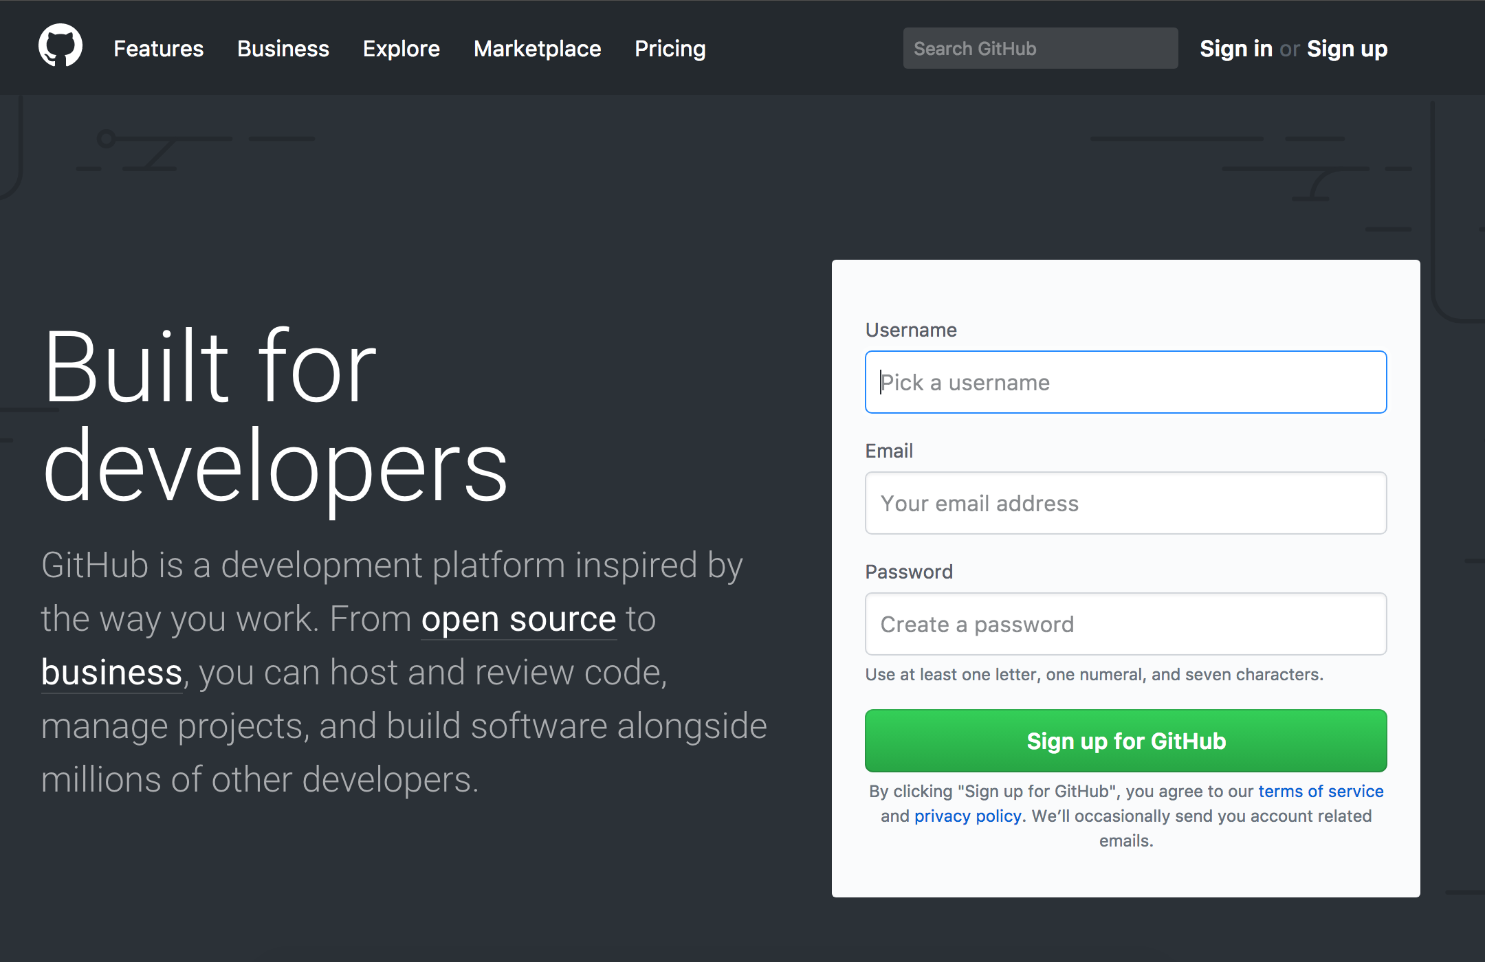
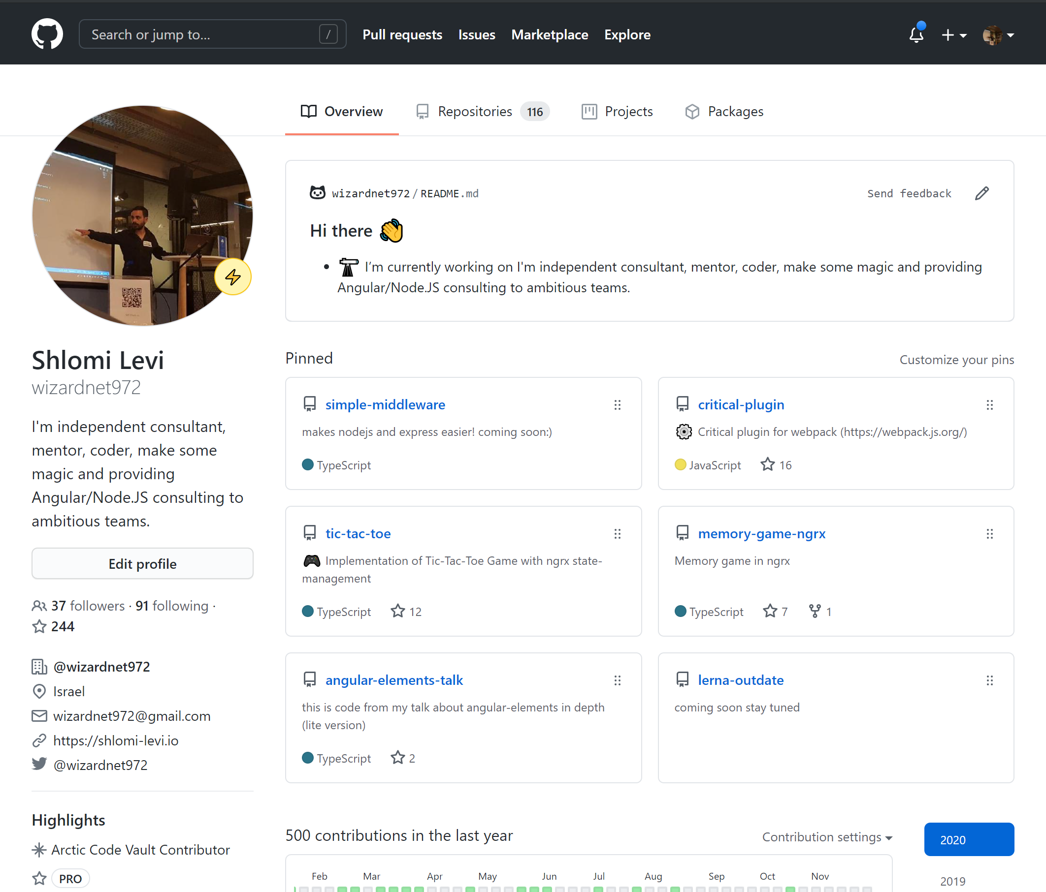
Example: github.com
@wizardnet972
Before Login
After Login
👇
👇

Slide 12
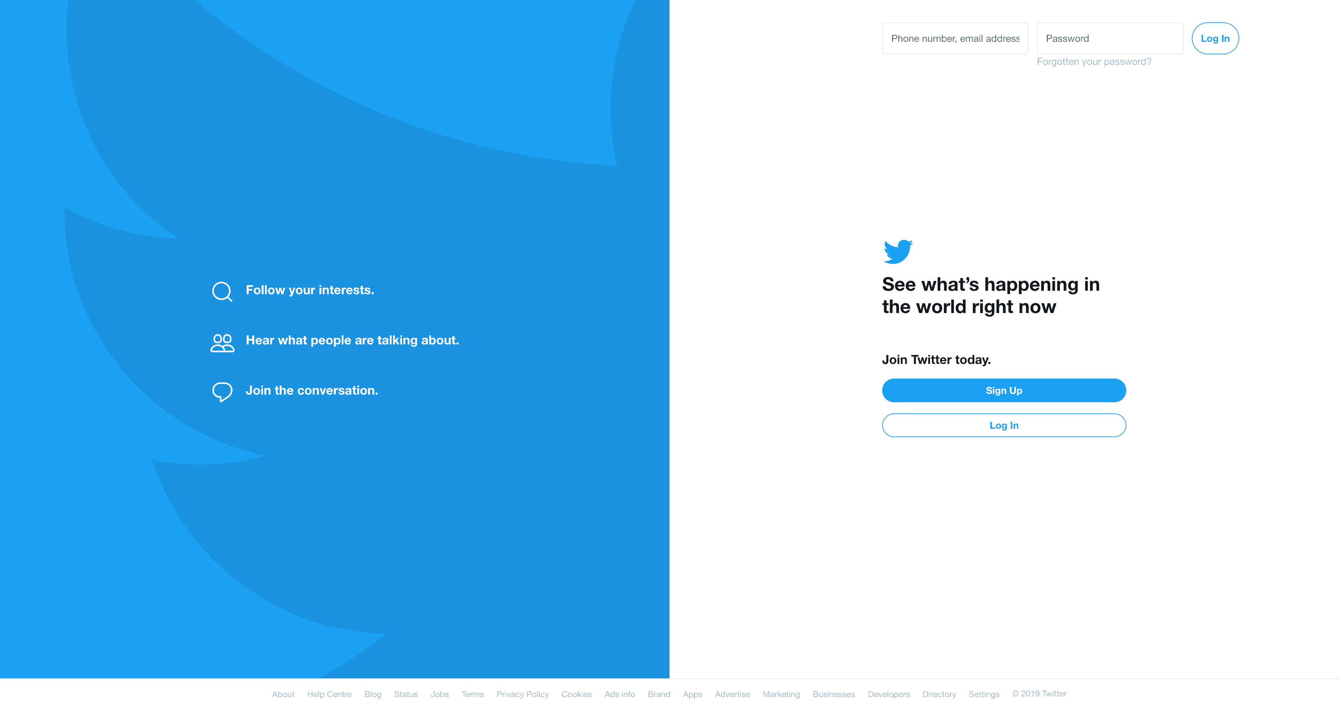
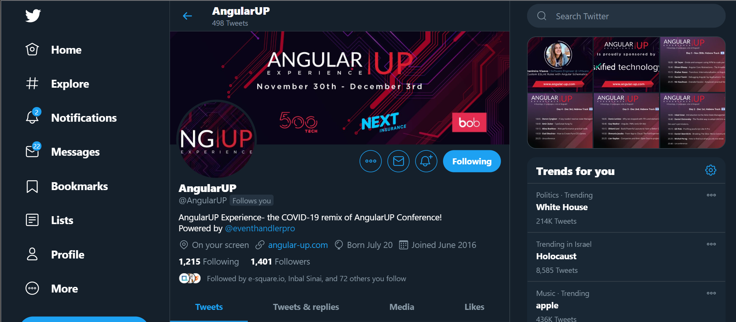
Example: twitter.com
@wizardnet972
Before Login
After Login
👇
👇

Slide 13
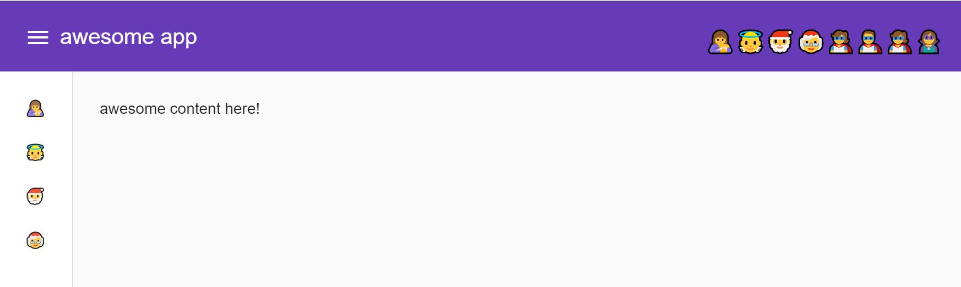
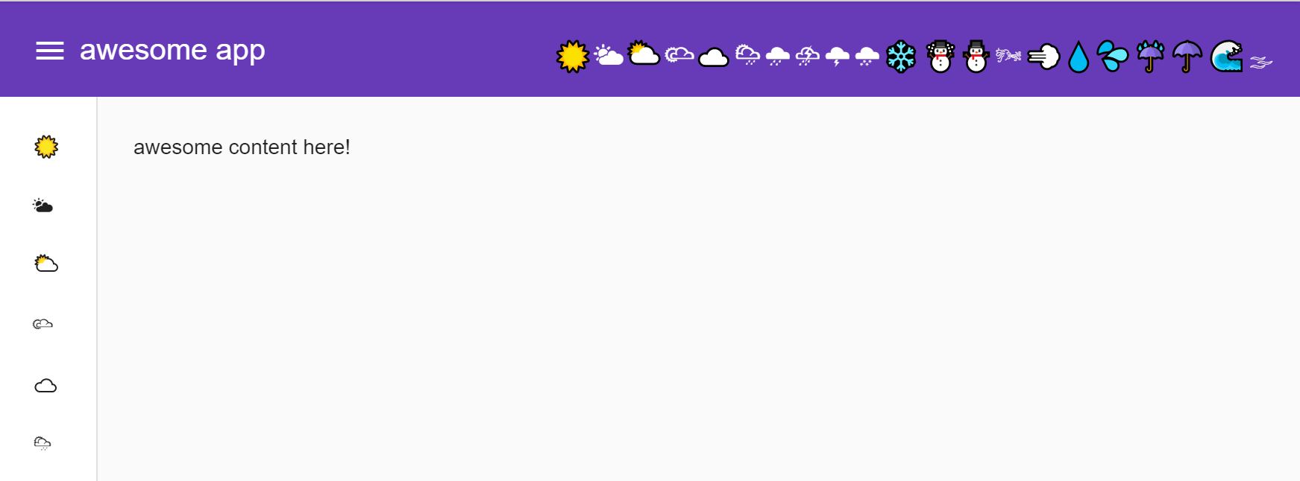
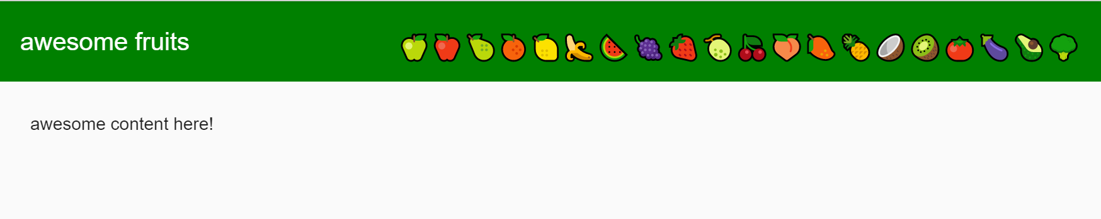
Case #1 - By Role:
@wizardnet972
👈
👈
Shlomi
👈
👈
Dani
👉🏼
👈
Israel Aharoni
👈

Slide 14
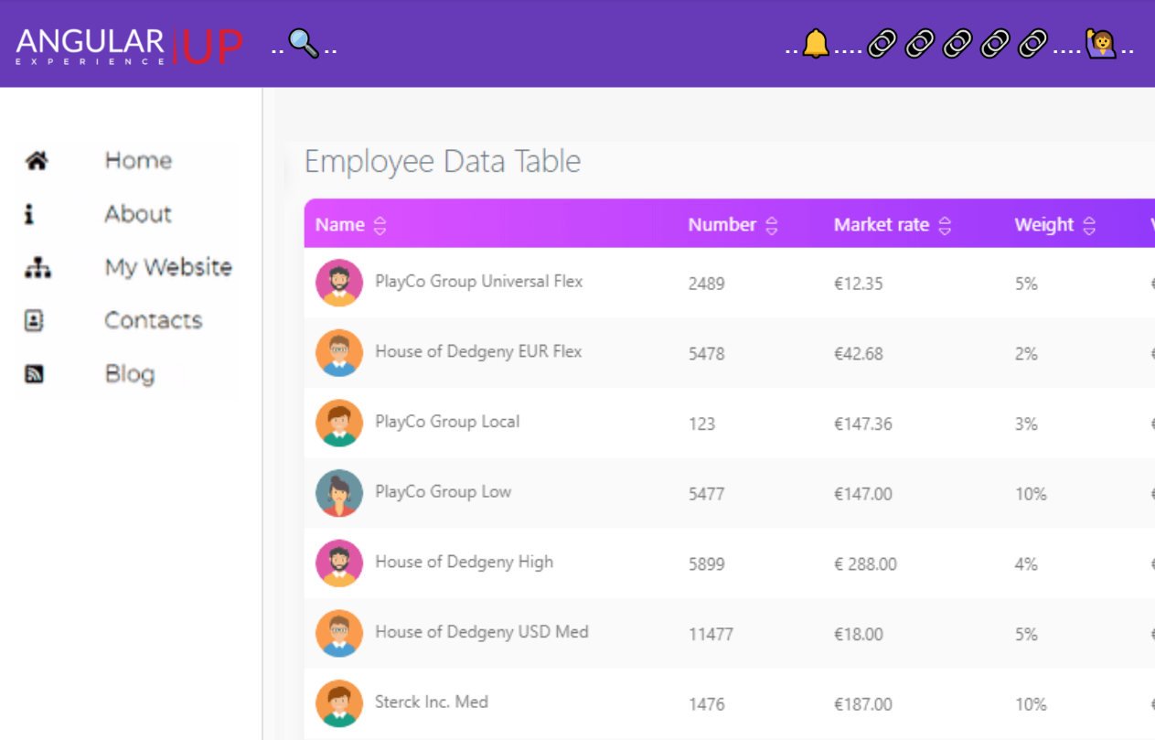
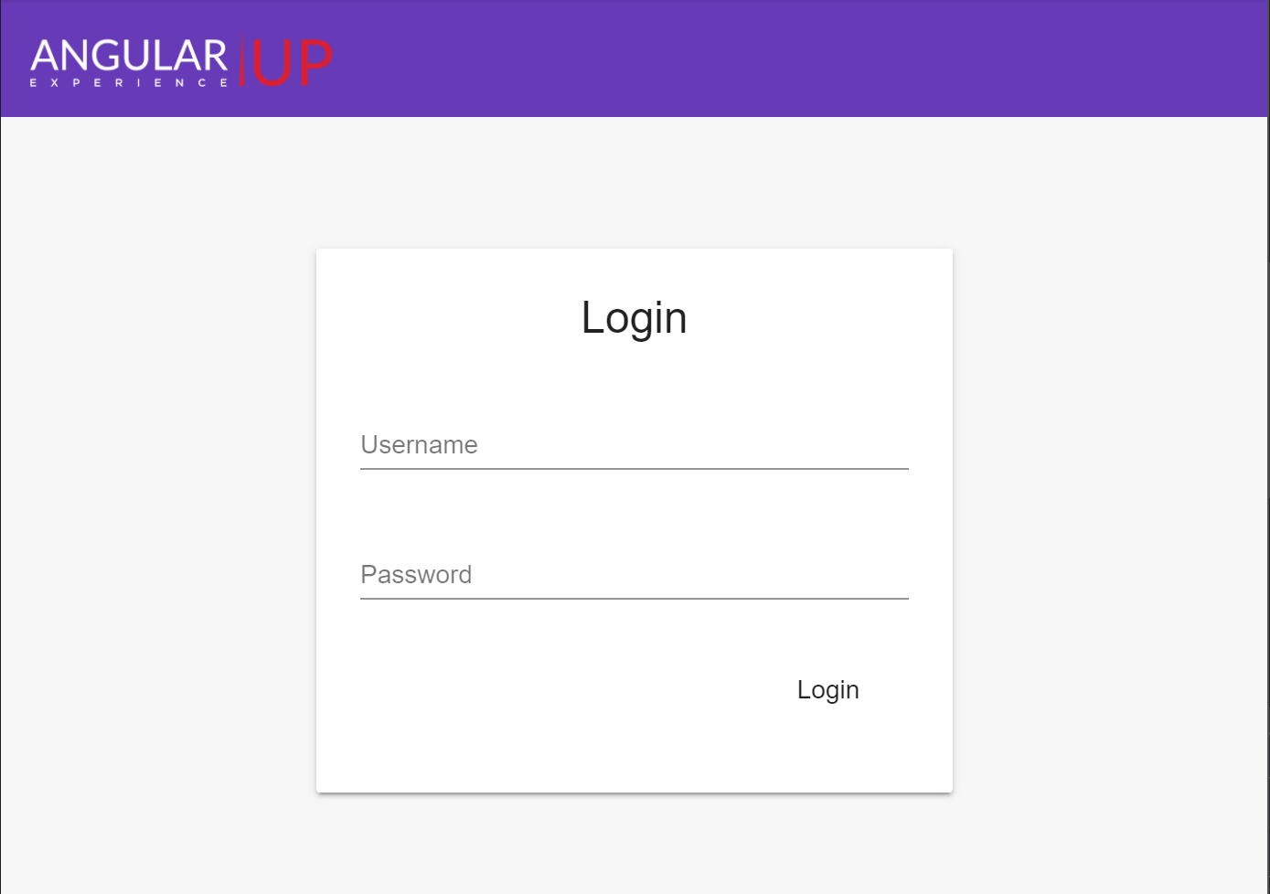
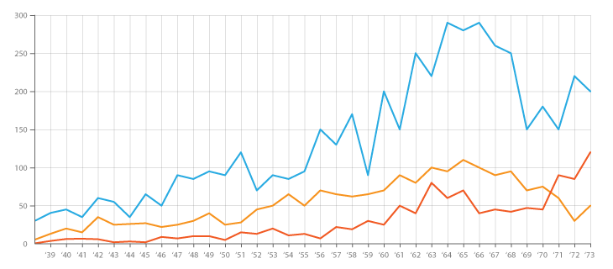
Case #2
@wizardnet972
👈
⌛
👉🏼
👈
frontend mode
auth mode
👈
fullscreen mode

Slide 15
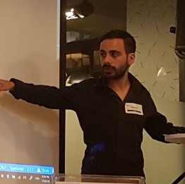
Consultant, Architect and trainer
Angular and Node.JS Specialist
SHLOMI LEVI
@wizardnet972
B2C - Web technologies
https://shlomi-levi.io

Slide 16
Case #2
@wizardnet972
👈
⌛
👉🏼
👈
auth mode
frontend mode
👈
fullscreen mode

Slide 17
app-shell
@wizardnet972
<toolbar>
<logo>... Angular-UP ... </logo>
<search> ...<input>... 🔍... </search>
<notifications>... 🔔 ... </notifications>
<div class="links">
<a [routerLink]="🔗" *ngFor="let 🔗 of links">{{🔗}}</a>
</div>
<user-status>
...
<ng-container *ngIf="isLogin; else auth">🙋‍♂️</ng-container>
<ng-template #auth>
<a [routerLink]="🔗" *ngFor="let 🔗 of loginAndRegisterLinks">{{🔗}}</a>
</ng-template>
...
</user-status>
</toolbar>
<section class="content">
<drawer>
<div class="drawer-links">
<a [routerLink]="🔗" *ngFor="let 🔗 of drawerLinks">{{🔗}}</a>
</div>
</drawer>
<main>
<router-outlet></router-outlet>
</main>
</section>
✔️
frontend mode
❌
auth mode
❌
fullscreen mode

Slide 18
app-shell
@wizardnet972
<toolbar>
<logo>... Angular-UP ... </logo>
<user-status>
...
<ng-container *ngIf="isLogin; else auth">🙋‍♂️</ng-container>
<ng-template #auth>
<a [routerLink]="🔗" *ngFor="let 🔗 of loginAndRegisterLinks">{{🔗}}</a>
</ng-template>
...
</user-status>
<div class="links" [ngClass]="hidden: !isLogin">
<a [routerLink]="🔗" *ngFor="let 🔗 of links">{{🔗}}</a>
</div>
<notifications [ngClass]="hidden: !isLogin">... 🔔 ... </notifications>
<search [ngClass]="hidden: !isLogin"> ...<input>... 🔍... </search>
</toolbar>
<section class="content">
<drawer [ngClass]="hidden: !isLogin">
<div class="drawer-links">
<a [routerLink]="🔗" *ngFor="let 🔗 of drawerLinks">{{🔗}}</a>
</div>
</drawer>
<main>
<router-outlet></router-outlet>
</main>
</section>
.hidden {
display:none;
}
👈
👈
👈
✔️
frontend mode
✔️
auth mode
👈
❌
fullscreen mode

Slide 19
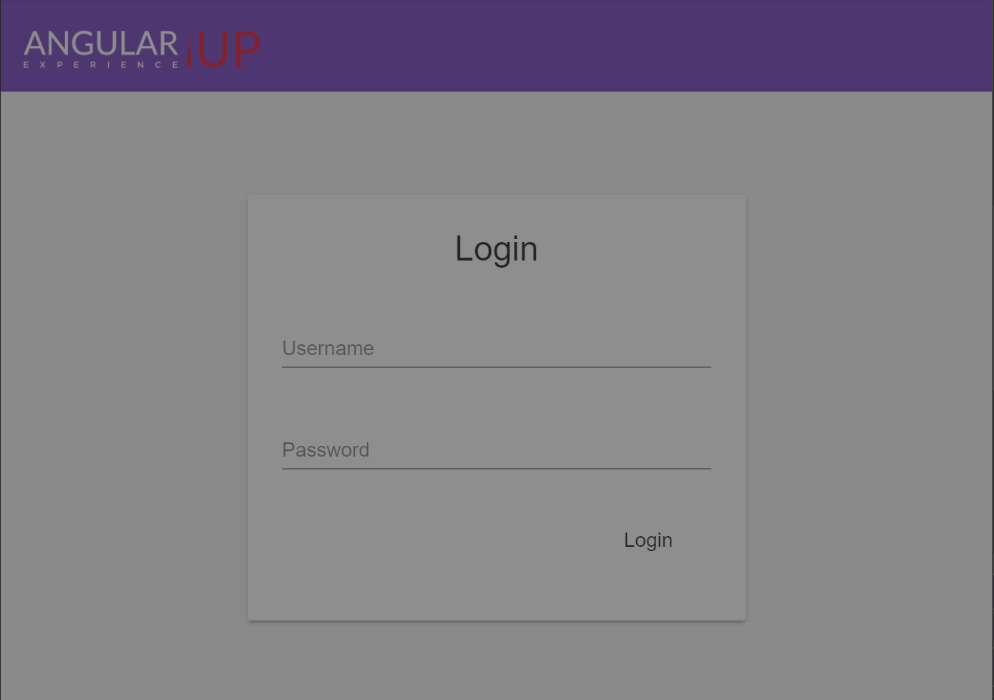
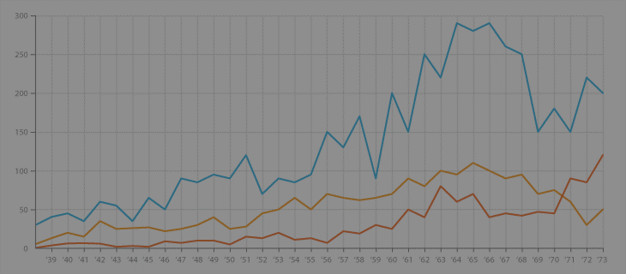
But..
@wizardnet972
👈
⌛
👉🏼
👈
auth mode
frontend mode
👈
fullscreen mode

Slide 20
app-shell
@wizardnet972
<toolbar>
<logo>... Angular-UP ... </logo>
<user-status>
...
<ng-container *ngIf="isLogin; else auth">🙋‍♂️</ng-container>
<ng-template #auth>
<a [routerLink]="🔗" *ngFor="let 🔗 of loginAndRegisterLinks">{{🔗}}</a>
</ng-template>
...
</user-status>
<div class="links" *ngIf="isLogin">
<a [routerLink]="🔗" *ngFor="let 🔗 of links">{{🔗}}</a>
</div>
<notifications *ngIf="isLogin">... 🔔 ... </notifications>
<search *ngIf="isLogin"> ...<input>... 🔍... </search>
</toolbar>
<section class="content">
<drawer *ngIf="isLogin">
<div class="drawer-links">
<a [routerLink]="🔗" *ngFor="let 🔗 of drawerLinks">{{🔗}}</a>
</div>
</drawer>
<main>
<router-outlet></router-outlet>
</main>
</section>
👈
👈
👈
✔️
frontend mode
✔️
👈
auth mode
❌
fullscreen mode

Slide 21
app-shell
@wizardnet972
👈
<toolbar *ngIf="!fullscreenMode">
<logo>... Angular-UP ... </logo>
<user-status>
...
<ng-container *ngIf="isLogin; else auth">🙋‍♂️</ng-container>
<ng-template #auth>
<a [routerLink]="🔗" *ngFor="let 🔗 of loginAndRegisterLinks">{{🔗}}</a>
</ng-template>
...
</user-status>
<div class="links" *ngIf="isLogin">
<a [routerLink]="🔗" *ngFor="let 🔗 of links">{{🔗}}</a>
</div>
<notifications *ngIf="isLogin">... 🔔 ... </notifications>
<search *ngIf="isLogin"> ...<input>... 🔍... </search>
</toolbar>
<section class="content">
<drawer *ngIf="isLogin || !fullscreenMode">
<div class="drawer-links">
<a [routerLink]="🔗" *ngFor="let 🔗 of drawerLinks">{{🔗}}</a>
</div>
</drawer>
<main>
<router-outlet></router-outlet>
</main>
</section>
👈
👈
👈
👈
✔️
frontend mode
👈
✔️
auth mode
✔️
fullscreen mode

Slide 22
Cool! Isn’t?
@wizardnet972
Let’s take a look again..

Slide 23
app-shell
@wizardnet972
<toolbar *ngIf="!fullscreenMode">
<logo>... Angular-UP ... </logo>
<user-status>
...
<ng-container *ngIf="isLogin; else auth">🙋‍♂️</ng-container>
<ng-template #auth>
<a [routerLink]="🔗" *ngFor="let 🔗 of loginAndRegisterLinks">{{🔗}}</a>
</ng-template>
...
</user-status>
<div class="links" *ngIf="isLogin">
<a [routerLink]="🔗" *ngFor="let 🔗 of links">{{🔗}}</a>
</div>
<notifications *ngIf="isLogin">... 🔔 ... </notifications>
<search *ngIf="isLogin"> ...<input>... 🔍... </search>
</toolbar>
<section class="content">
<drawer *ngIf="isLogin || !fullscreenMode">
<div class="drawer-links">
<a [routerLink]="🔗" *ngFor="let 🔗 of drawerLinks">{{🔗}}</a>
</div>
</drawer>
<main>
<router-outlet></router-outlet>
</main>
</section>
✔️
frontend mode
✔️
auth mode
✔️
fullscreen mode

Slide 24
app-shell
@wizardnet972
<toolbar>
<logo>... Angular-UP ... </logo>
<user-status>
...
🙋‍♂️
...
</user-status>
<div class="links">
<a [routerLink]="🔗" *ngFor="let 🔗 of links">{{🔗}}</a>
</div>
<notifications>... 🔔 ... </notifications>
<search> ...<input>... 🔍... </search>
</toolbar>
<section class="content">
<drawer>
<div class="drawer-links">
<a [routerLink]="🔗" *ngFor="let 🔗 of drawerLinks">{{🔗}}</a>
</div>
</drawer>
<main>
<router-outlet></router-outlet>
</main>
</section>
frontend layout

Slide 25
app-shell
@wizardnet972
auth layout
<toolbar *ngIf="!fullscreenMode">
<logo>... Angular-UP ... </logo>
<a [routerLink]="🔗" *ngFor="let 🔗 of loginAndRegisterLinks">{{🔗}}</a>
</toolbar>
<section class="content">
<main>
<router-outlet></router-outlet>
</main>
</section>

Slide 26
app-shell
@wizardnet972
fullscreen layout
<router-outlet></router-outlet>

Slide 27
Demo
@wizardnet972

Slide 28
What Next?
@wizardnet972

Slide 29
Thank you && Stay safe!
🙏
Code & Examples on GitHub:
https://github.com/wizardnet972/angularup-layouts
https://shlomi-levi.io
Email: wizardnet972@gmail.com
@wizardnet972

